Slide 1



ema
WELCOME TO
Digital Logbook Maintenance System
Presented By

Slide 2
ema
Group Members
Charlie B
Lt Ishrak Jahan Ema
Lt Labiba Islam
Lt Lopa Ahmed
Lt Tanvir Nahian Swapnil
Lt Safkat Rahman

Slide 3
ema
AIM
The Aim of the Presentation is to Give an Overview of Our Project

Slide 4
ema
Scopes
Project Proposal
Project Schedule
User Requirement
System Requirement Specifications
System Architechture
System Model
UI Design

Slide 5
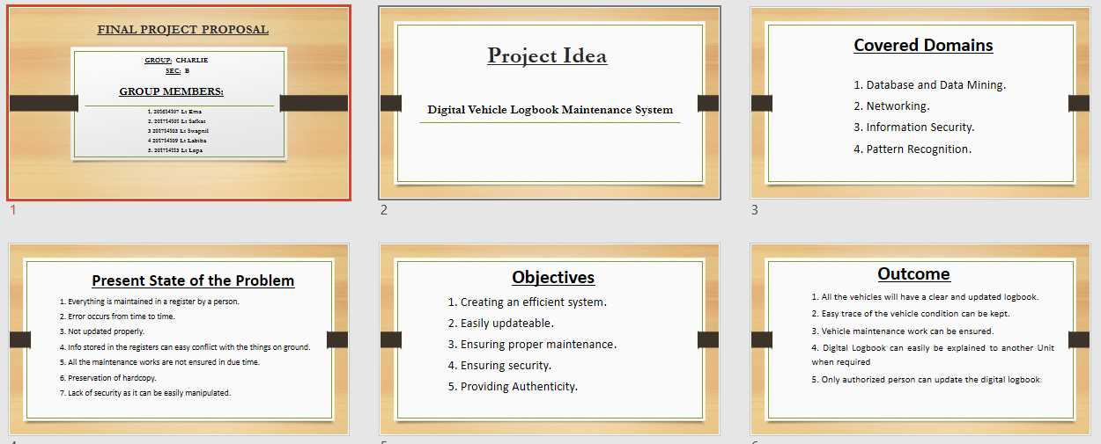
ema
Project Proposal

Slide 6
ema
Project Scheduling
We have tried to maintain the Project Timings Using the Microsoft Projects
The Start time of the project was 13th August 2020 And we have planned to end the project by 7th January 2021.
The overall project is going to be completed by The group members of Charlie B .

Slide 7
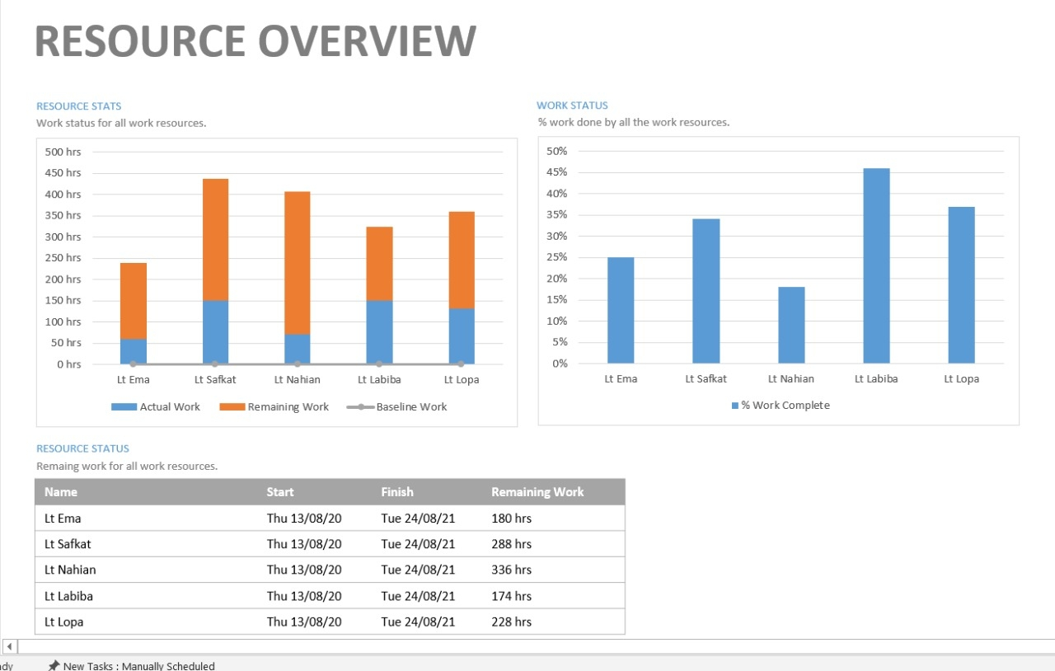
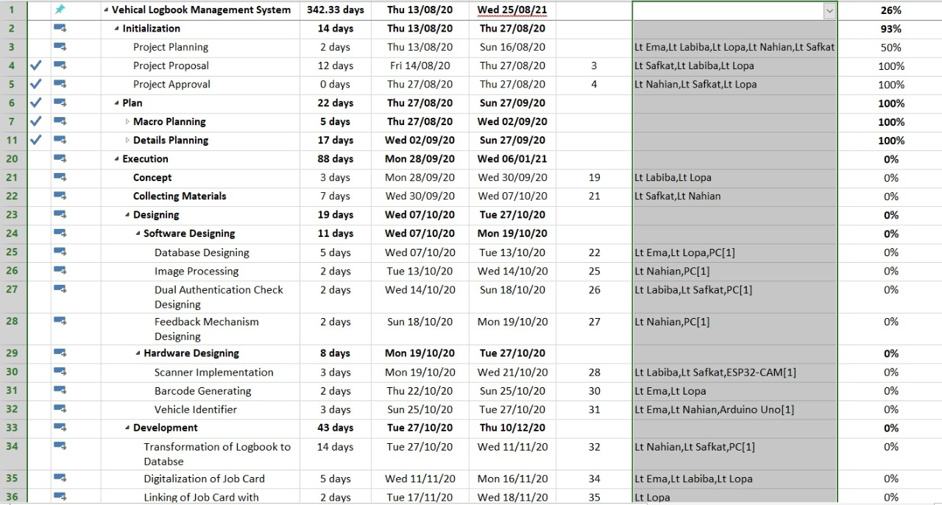
ema
Project Scheduling

Slide 8
lopa
User Requirements
Security has to be ensured and given with highest priority.
The product should have App version usable on mobile mainly for android.
The App should have access for Read-only purpose.
Digitalized version of logbook updating and maintenance should be provided.
Digitalized version for work order and job card to be provided.
Authentication system must be provided from both user unit and workshop.
Repair process mainly spare parts supply should be digitalized.

Slide 9
lopa
System Requirements Specifications
System Requirements
Image Processing App version
Desktop version
Authentication approval
Overall supervision
System Requirements
Authentication checking
Updating database from Job Card
Digitalization of repair process
Job card updating

Slide 10
lopa
System Requirements Specifications
Requirement Classification
Serial | User Requirements | Types Of Requirement
 |  | Functional | Non-Functional
1 | The App should be highly secured | X | √
2 | The App should be portable in mobile devices | √ | √
3 | The App should be able to be read-only purposes | √ | X
4 | Digitalization of logbook updating and maintenance | √ | X
5 | Authentication system | √ | X
6 | Digitalization of spare parts supply process | √ | X
7 | Digitalization of work orders and job card | √ | X
8 | Overall monitoring system | √ | X

Slide 11
lopa
System Architecture
User Interface
Work Order Management
View Logbook
Scan
Vehicle
User Interface Management Authentication
Identification Of Vehicle
Job Card Management
Authorization
App Service /
Business Logic
Scan Parts
Info Update
Feedback
Verification
System Support
Search
Logbook Storage
Login and Monitoring

Slide 12
labiba
System Model
Context Diagram
R I & I
View Logbook
Job Card Data
Workshop Officer
View Logbook
Authentication Request
Update Logbook
Permission
Authentication Confirmation
Vehicle
DLMS
BA Number
Workshop NCO
Quarter Master
Work Order
Authority
Servicing Report
Maintenance Report
View Logbook
Ok Report

Slide 13
labiba
System Model
Use Case Diagram
User
System
Admin
Authentication
View Logbook
Workshop Officer
Generate WO
Close Logbook
Quarter Master
Update Logbook
R I & I
Scenario From Unit end

Slide 14
labiba
System Model
Use Case Diagram
Admin
System
Admin
Job Card Open
Scanning of vehicles and parts
Issue of parts
Workshop NCO
Date of repairing
Update logbook
R I & I
Verification
Workshop Officer
Closing Report
Scenario From Workshop End

Slide 15
labiba
System Model
Log in
Activity Diagram
No
Authentication
check
Yes
View Logbook
Homepage
Vehicle require maintenance
Yes
Generate WO
Insert Info
Scenario From Unit End
No
Authorization
Send
Log Out

Slide 16
labiba
System Model
Login
No
Authentication Check
Activity Diagram
Yes
Home
View Logbook
Generate Job Card
Authorization Notification
Entries
Next Maintenance Date
Scan vehicle
Verification
Scan parts
Closing
Scenario From Workshop End
Repair Input
Update
Log Out

Slide 17
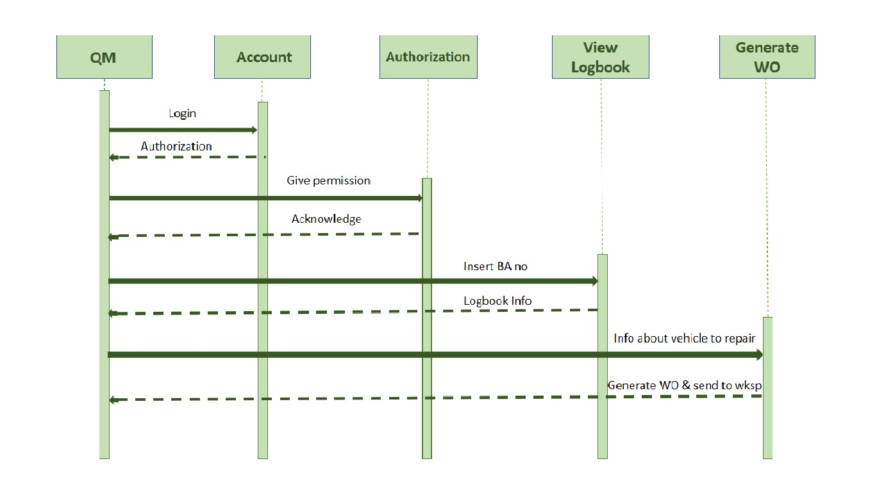
labiba
System Model
Sequence Diagram
Scenario From Unit End

Slide 18
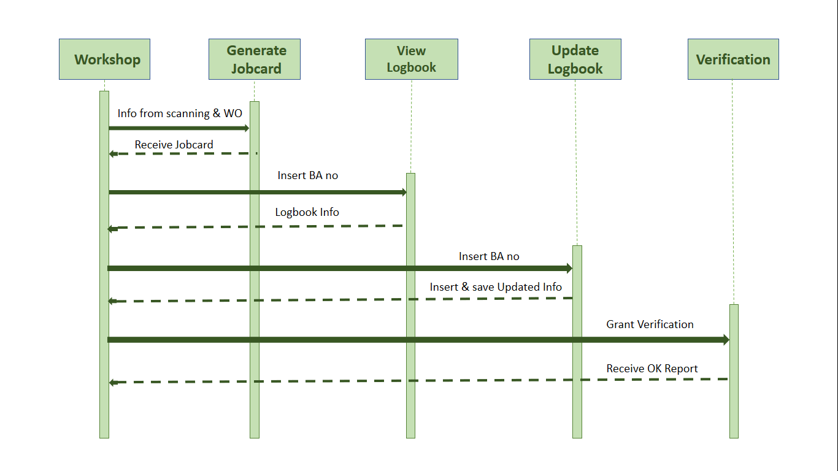
labiba
System Model
Sequence Diagram
Scenario From Workshop End

Slide 19


safkat
User Interface Design
WELCOME TO
Login…
User Name
Password
Submit
Register

Slide 20
safkat
User Interface Design
Welcome To
View Logbook
Generate Work Order
QM
Log Out

Slide 21
safkat
User Interface Design
View Logbook
Welcome To
Create New Logbook
Update Logbook
Generate Job Card
R I & I
Log Out

Slide 22
safkat
User Interface Design
Welcome To
View Logbook
Authentication Notification
Wksp Offr
Log Out

Slide 23
safkat
User Interface Design
Welcome To
User Name
*
Password
*
Re-Enter Password
*
Choose Your Appointment
*
Unit Name
*
Register
Unit Location
*
Verify And Submit

Slide 24
swapnil
User Interface Design
Welcome To
Next Maintenance Date
Issue Date
Oil Change Details
LOG BOOK
Filter Change Details
Repair Details
Return
Parts Issue Details
Update

Slide 25
swapnil
User Interface Design
Welcome To
Date
*
BA Number
*
Running Kilometer
*
Problem
*
Work
Order
QM Password
*

Slide 26
swapnil
User Interface Design
Job Card
Unit Name
Job Card Number
Start Date(IN)
Work Order Number
Problem
Remarks
End Date(OUT)
Vehicle Model
Corrector
Inspector
Continue …

Slide 27
swapnil
User Interface Design
Continued
gallon
Fuel In out Time
DIGITAL SIGN
gallon
IN
OUT
Workshop Officer
Unit Name
Issued Spare Parts
Remarks
Serial
Date
Reference
Part No
Detailed Name
Amount

Slide 28
swapnil

